Slide 1
Work Plan for Sea Ice Flagging

Slide 2
Main Module
3 integers
Number of pixel
Number of lines
Number of H and V sigma files
Control File
Month (MM) extracted from ……25km…..YYYYMMDD.bin
Climatology file of the extracted month
Threshold values – Sigma, APR, SD
Ice Flagging code
Current date data is fed
Process code 0,1
no error/error in flagging
0
1
Repeat for other three image
3 Sigma V
3 Sigma H
Produce climatology

Slide 3
CtrlIOerr
Error in reading input files from control file
Subroutines/Subprograms
(Functions)
SigFileOpenErr
Error in opening sigma files
ReadClimatology
Reading climatology file
ReadSigma
Reading H and V sigma files
SigFileReadErr
Error in reading H and V sigma files
Compute_LinSigma
Convert Sigma from dB to Linear
Compute_APR
Computing APR from H and V polarization
Compute_SD
Computing SD
Generate_IceFlag
Derive ice layer
WriteIceFlagFile
Write the Ice flag image

Slide 4
Variables
4
1440
720
4
nimg
npix
nlin
month
Table 1: Look up Table
11
10
Value | Feature
0 | Open Ocean
2 | Land Ice
3 | Land
10 | Open Ocean in poles
11 | Sea Ice
111 | Error
IceIceVal
IceOceanVal
defining climatology data
0
1
NoData
IceFlagVal
ClimateIceVal
ErrClimateVal
111
-1
-10000
0
NoData0
NoData2
NonIceVal
Process_code
SeaIceFlag
IceFlag
NoDataImage
historical month for masking
climatology
OLDCL
previous day

Slide 5
Variables
sigvin
sighin
sigvlin
sighlin
standard deviation
STD_H
STD_V
apr
3-D array for four days
to fed sigma files
signvfile
sighfile
to fed the control file
Cice_controlfile
climatefile
to fed the climatology file
SeaIceFile
ThrFile
FlagCodeFile
OldClimateFile
vunit
hunit
SCALE
BIAS

Slide 6
Program
Open pre-defined control file
Read control file
Reading total number of pixels, lines and number of files
Read Sigma files
Allocating space for arrays and defining variables
No. of days <= 2, reproduce climatology
Read and Generate sigma stack [nimg,nline,npix]
Reading input and control files
Compute linear sigma
Defining codes for features using look up table
If process code = 0, continue and read Sigma files
Compute APR
Read climatology file
If process code = 1, reproduce climatology and exit
Compute SD of both the polarization
Generate sea ice flag
Write the sea ice flag in binary

Slide 7
SIF_25km_20240701 to SIF_25km_20240710
For 12 km
For 25 km
1⁰ = 100 km
? = 12 km
=0.125⁰
1 pixel = 0.125⁰
? = 360⁰
No. of pixel = 2880 pixel
? = 180⁰
No. of pixel = 1440 pixel
1⁰ = 100 km
? = 25 km
=0.250⁰
1 pixel = 0.250⁰
? = 360⁰
No. of pixel = 1440 pixel
? = 180⁰
No. of pixel = 720 pixel

Slide 8
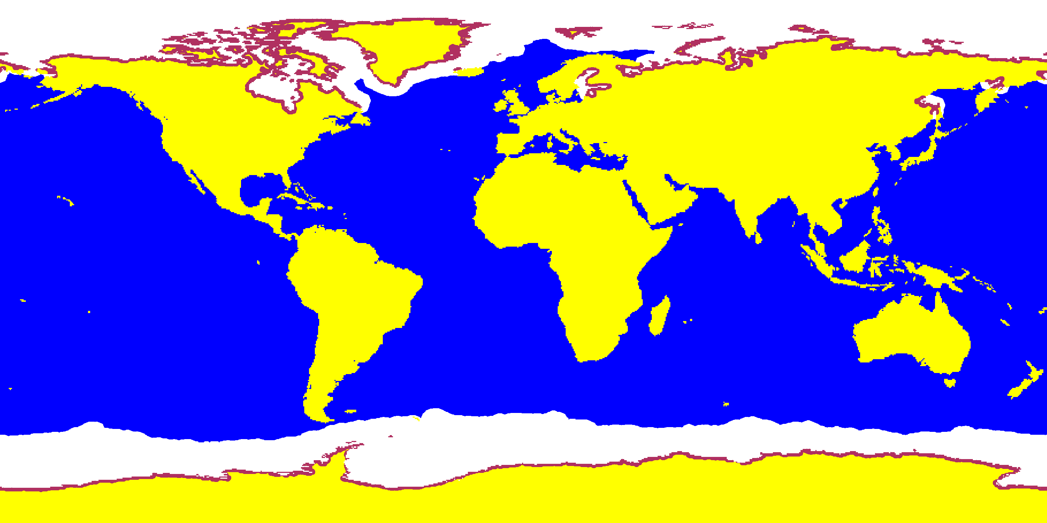
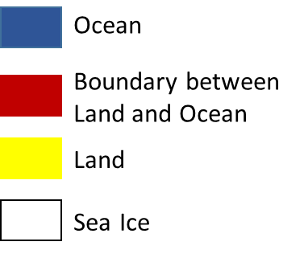
SIF_25km_20240701 to SIF_25km_20240710

Slide 9
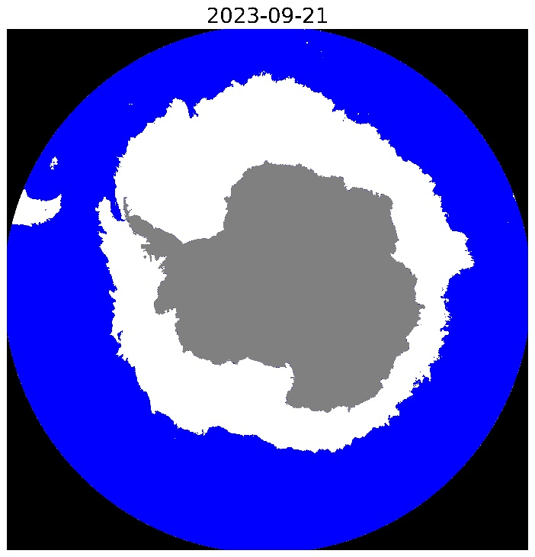
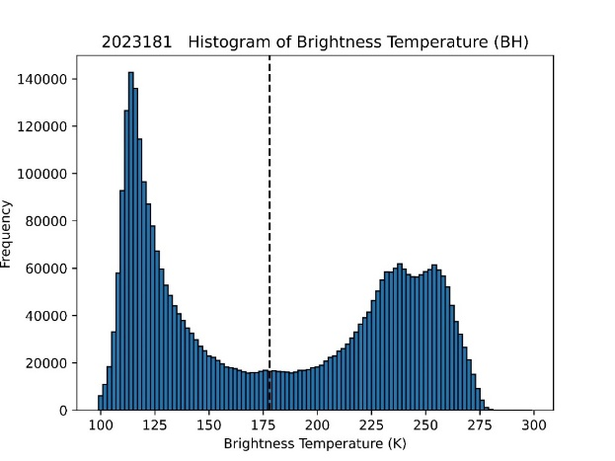
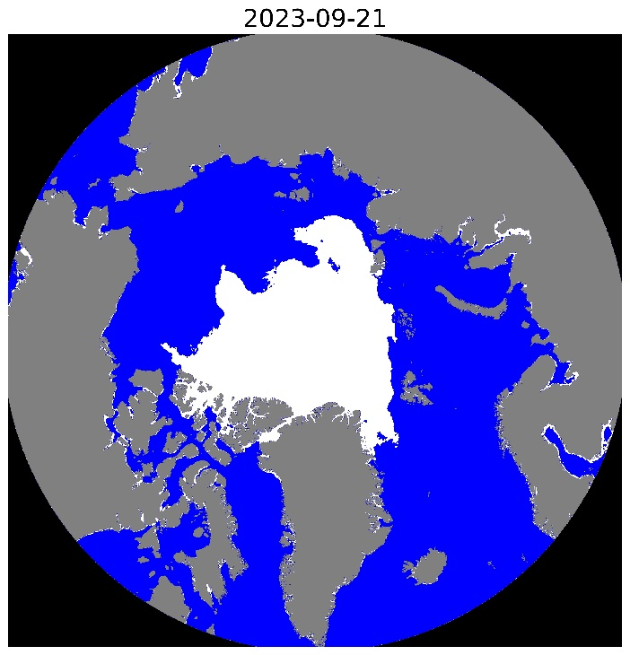
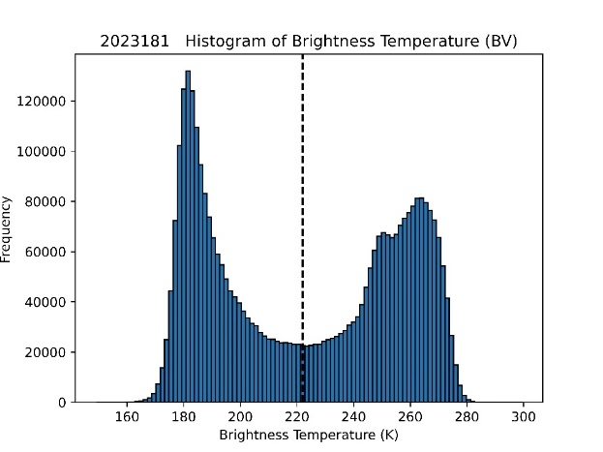
Results: Sea Ice Extent Algorithm and Validation
Algorithm for Sea Ice Discrimination
OS3 Scatterometer Dataset
Brightness Temperature (BT) (H and V polarization)
(DN x scale value) + offset
Defining Threshold
Classification of sea ice and water
Generating sea ice maps

